Slide 1
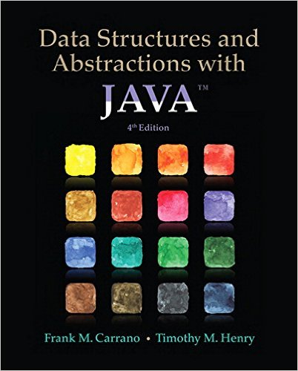
Lecture 5
Recursion: Chapter 7

Slide 2
Contents
What Is Recursion?
Tracing a Recursive Method
Recursive Methods That Return a Value
Recursively Processing an Array
Recursively Processing a Linked Chain
The Time Efficiency of Recursive Methods
  The Time Efficiency of countDown

Slide 3
Contents
A Simple Solution to a Difficult Problem
A Poor Solution to a Simple Problem
Tail Recursion
Indirect Recursion
Using a Stack Instead of Recursion

Slide 4
Objectives
Decide whether given recursive method will end successfully in finite amount of time
Write recursive method
Estimate time efficiency of recursive method
Identify tail recursion and replace it with iteration

Slide 5
What Is Repetition?
A major feature of many algorithms that involves repeating actions many times
Iteration
  Implemented by loop constructs:
    for
    while
    do-while
  Two types:
    Counted loop
    Or executed repeatedly while a loop condition is true
Recursion

Slide 6
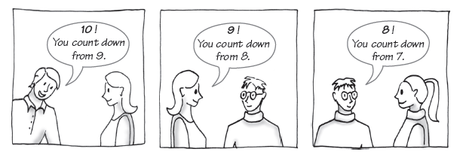
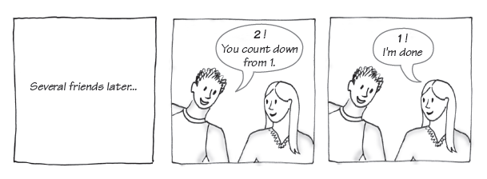
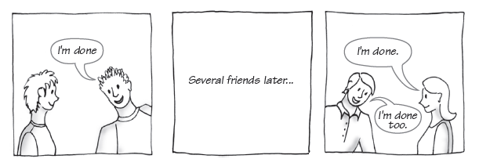
Figure 7-1 Counting down from 10

Slide 7
An Iterative Solution to count down to 1
public static void countDown( int integer )
{
do
{
System.out.println( integer );
integer--;
} while( integer > 0 );
}

Slide 8
What Is Recursion?
We often solve a problem by breaking it into smaller problems that are identical (except for size)
We repeat smaller problems until problem with known solution is reached
Example: Counting down from 10 to 1

Slide 9
What Is Recursion?
If a problem can be solved:
  utilizing solutions to smaller versions of the same problem,
  and the smaller versions reduce to easily solvable cases, then one can use a recursive algorithm to solve that problem.
  A recursive algorithm is an algorithm which calls itself with "smaller (or simpler)" input values, and which obtains the result for the current input by applying simple operations to the returned value for the smaller (or simpler) input.

Slide 10
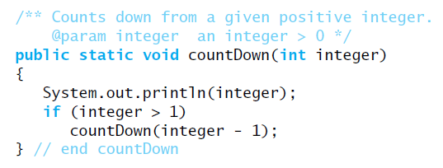
What Is Recursion
A method that calls itself is a recursive method.
Example:
  countDown
public static void countDown( int integer )
{
do
{
System.out.println( integer );
integer--;
} while( integer > 0 );
}

Slide 11
Design Guidelines
Method must receive input value
Must contain logic that involves this input value and leads to different cases
  typically such logic includes if statement(s) or a switch statement
One or more cases should provide solution that does not require recursion
  Base case or stopping case
One or more cases must include recursive invocation of method
  these recursive invocations take a step towards a base case by using “smaller” arguments

Slide 12
Design of Recursive Solution
When does process end?
  What smaller but identical problem has known solution
  How do you reach this problem?
    Identify base case (more than one possible)
What smaller (identical) problem has solution that
  When taken with your contribution
  Provides the solution to the original problem
    Identify recursive invocation (more than one possible)
If needed, more than one return statement per method recommended

Slide 13
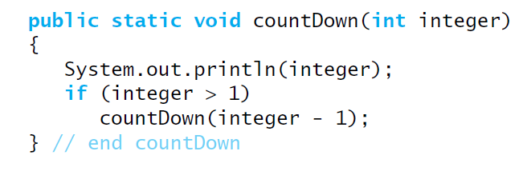
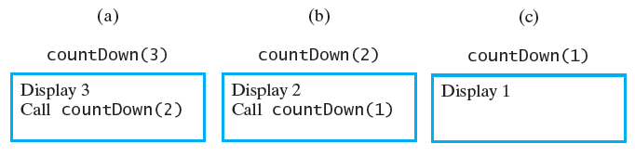
Tracing Recursive Method
Given recursive countDown method
  Trace of the method call countDown(3):

Slide 14
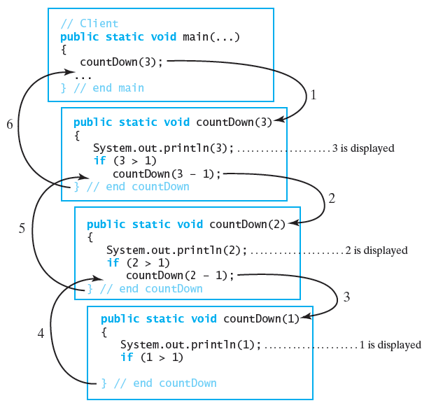
Figure 7-3 Tracing the recursive call countDown(3)

Slide 15
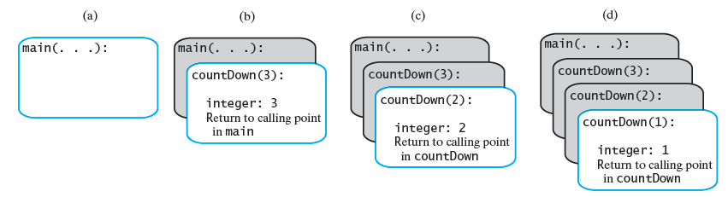
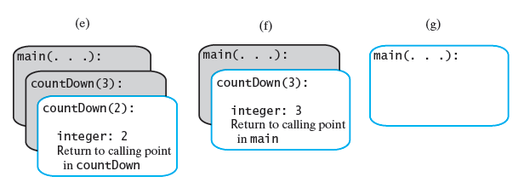
FIGURE 7-4 The stack of activation records during the execution of the call countDown(3)

Slide 16
Recursive Methods That Return a Value
Example:
  Compute the sum 1 + 2 + . . . + n
  For any integer n > 0.
public static int sumOf(int n)
{
if (n == 1)
return 1;
else
return sumOf(n-1) + n;
}
Note: multiple return statements to save on number of local variables to be put on activation records

Slide 17
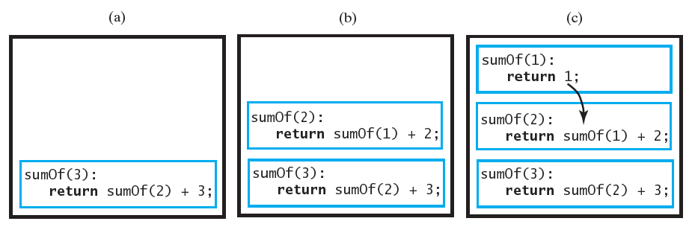
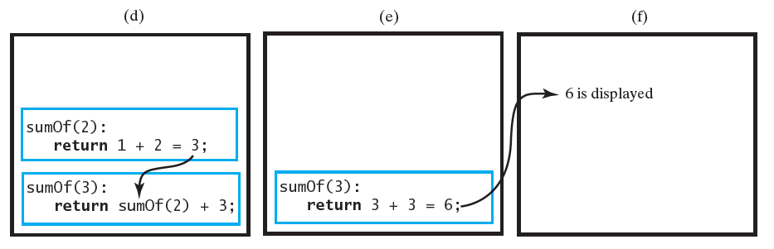
Figure 7-5 Tracing the execution of sumOf(3)

Slide 18
Recursively Processing an Array
When processing array recursively, divide it into two pieces, either
  First element one piece, rest of array another, or
  Last element one piece, rest of array another, or
  Divide array into two halves/partitions
A recursive method part of an implementation of an ADT is often private
  Its necessary parameters make it unsuitable as an ADT operation
  A public method redirects the call
public void display()
{
displayArray(myArray, 0, length-1)
}

Slide 19
Recursively Processing an Array
public void display()
{
displayArray(myArray, 0, length-1);
}
Starting with array[first] – method 1
Trace call display(); for array a = {7,5,8,1};
private void displayArray(int array[], int first, int last){
System.out.print(array[first] + " ");
if (first < last)
displayArray(array, first+1, last);
}
display()
displayArray(a,0,3);
  first:0 last:3
  sop:7
  first < last ? - yes
  displayArray(a,1,3);
    first:1 last:3
    sop:5
    first < last ? - yes
    displayArray(a,2,3);
      first:2 last:3
      sop:8
      first < last ? - yes
      displayArray(a,3,3);
        first:3 last:3
        sop:1
        first < last ? - no

Slide 20
Recursively Processing an Array
public void display()
{
displayArray(myArray, 0, length-1)
}
Starting with array[last] – method 2
private void displayArray(int array[], int first, int last)
{
if (first <= last)
{
displayArray(array, first, last-1);
System.out.print(array[last] + " ");
}
}

Slide 21
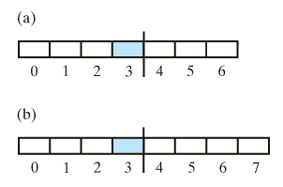
Recursively Processing an Array
  Must find element at or near middle
int mid = (first + last) / 2;
  Will utilize improved formula:
int mid = first + (last - first) / 2;
public static void displayArray(int array[], int first, int last)
{
if (first == last)
System.out.print(array[first] + " ");
else
{
int mid = first + (last - first)/2;
displayArray(array, first, mid);
displayArray(array, mid+1, last);
}
}

Slide 22

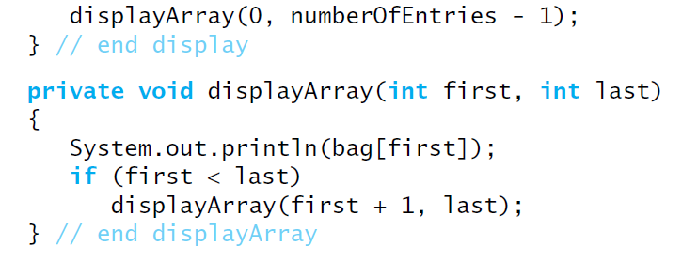
Displaying a Bag Recursively
When implemented with an array

Slide 23
Recursively Processing a Linked Chain
To write a method that processes a chain of linked nodes recursively:
  Use a reference to the chain's first node as the method's parameter
  Then process
  the first node
  Follow by the
  rest of the chain
Q: How would you display the chain backwards?
public void display()
{
displayChain(this.firstNode);
System.out.println();
}
private void displayChain(Node currentNnode)
{
if (currentNnode != null)
{
System.out.print(currentNnode.data);
displayChain(currentNnode.next);
}
}

Slide 24
Recursively Processing a Linked Chain
How about:
public void displayBackward ()
{
displayChainBackward (this.firstNode);
}
private void displayChainBackward (Node currentNnode)
{
if (currentNnode != null)
{
displayChainBackward (currentNnode.next);
System.out.println (currentNnode.data);
}
}
Display last node, then next-to-last, etc.
  Recursive implementation
  Easier than an iterative implementation

Slide 25
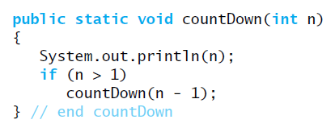


Time Efficiency of Recursive Methods
Consider method countdown
Recurrence relation
Proof by induction shows
Thus method is O(n)

Slide 26
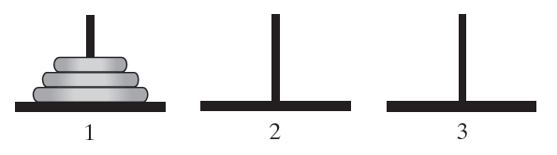
Simple Solution to a Difficult Problem
Consider Towers of Hanoi puzzle
Rules
  Move one disk at a time. Each disk you move must be a topmost disk.
  No disk may rest on top of a disk smaller than itself.
  You can store disks on the second pole temporarily, as long as you observe the previous two rules.

Slide 27
Solution
Move a disk from pole 1 to pole 3
Move a disk from pole 1 to pole 2
Move a disk from pole 3 to pole 2
Move a disk from pole 1 to pole 3
Move a disk from pole 2 to pole 1
Move a disk from pole 2 to pole 3
Move a disk from pole 1 to pole 3

Slide 28
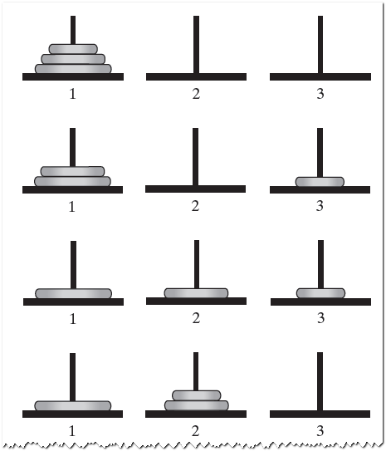
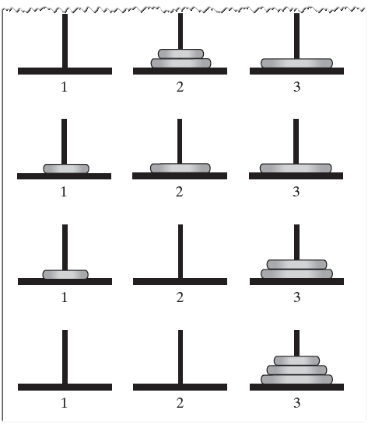
Figure 7-8 The sequence of moves for solving the Towers of Hanoi problem with three disks

Slide 29
Recursive Solution
To solve for n disks …
  Ask friend to solve for n – 1 disks
  He in turn asks another friend to solve for n – 2
  Etc.
  Each one lets previous friend know when their simpler task is finished

Slide 30
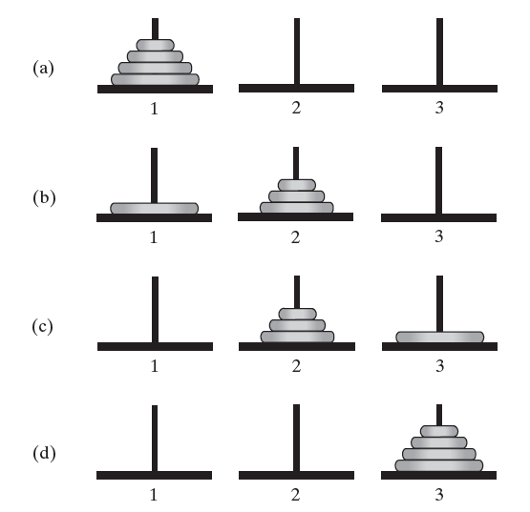
Figure 7-9 The smaller problems in a recursive solution for four disks

Slide 31
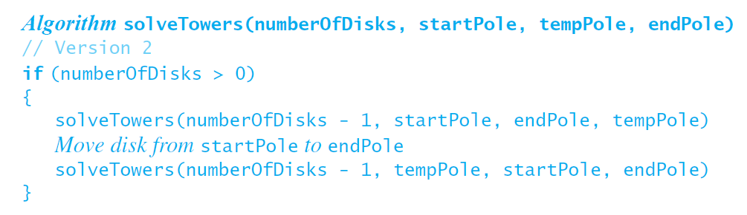
Recursive Algorithm

Slide 32
Efficiency of Towers of Hanoi
m(1)=1; m(2)=3; m(3)=7; m(4)=15; m(5) =31; …
m(n) = 2^{n} – 1
The efficiency is Ο(2^{n})
  If 2⁶⁰ = 1,152,921,504,606,846,976 - how long would it take to move 64 disks?
  Invented in the late 1800, the Towers of Hanoi was accompanied by this legend: “A group of monks was said to have begun moving 64 disks from one tower to another. When they finish, the world will end”. Well, 2⁶⁴ is a quite a number of moves, so by the time they finish, it is quite possible that the disks, if not the word, will have worn out!

Slide 33
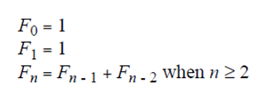
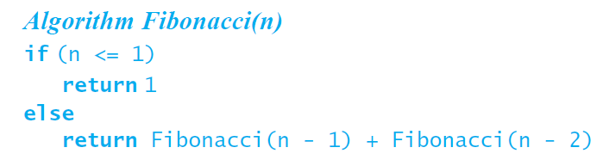
Poor Solution to a Simple Problem
Fibonacci sequence
1, 1, 2, 3, 5, 8, 13, …
Suggests a recursive solution
Note the two
recursive calls

Slide 34
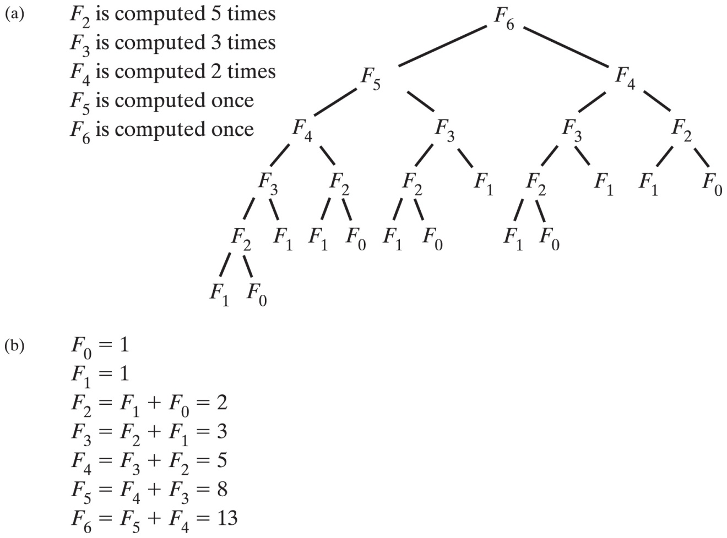
A Poor Solution to a Simple Problem
In recursive implementation time efficiency grows exponentially with n due to repetitive computation
Conclusion: Do not use recursive solution that repeatedly solves same problem in its recursive calls.
Iterative solution is O(n)
The computation of the Fibonacci number F₆
(a) recursively; (b) iteratively

Slide 35
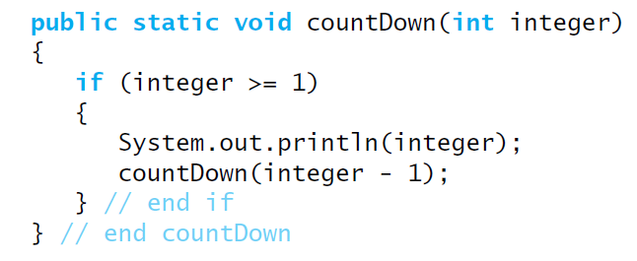
Tail Recursion
When the last action performed by a recursive method is a recursive call
Example:
Repeats call with change in parameter or variable

Slide 36
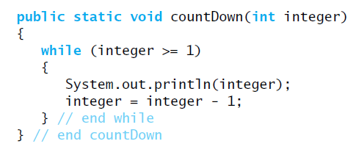
Tail Recursion
Consider this simple change to make an iterative method
  Replace if with while
  Instead of recursive call, subtract 1 from integer
Change of tail recursion to iterative often simple

Slide 37
Mutual Recursion
Another name for indirect recursion
Happens when Method A calls Method B
  Which calls Method C
  Which calls Method A
  etc.
Difficult to understand and trace
  Happens naturally in certain situations
Longer chains possible
  Invocation cycles
  Even more difficult to understand

Slide 38
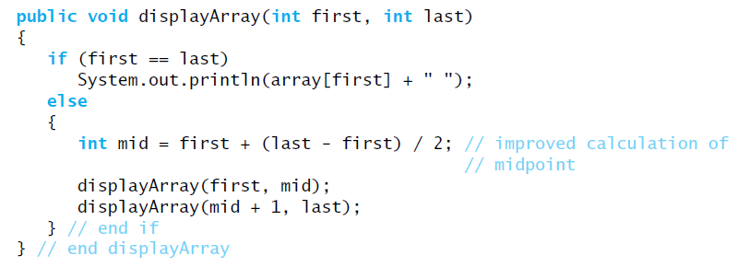
Using a Stack Instead of Recursion
A way of replacing recursion with iteration
Remember recursive displayArray

Slide 39
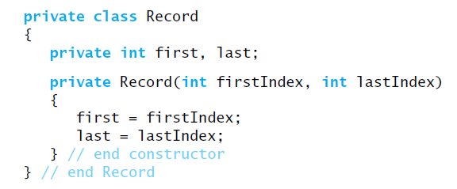
Using a Stack Instead of Recursion
We make a stack that mimics the program stack
  Push Record objects onto stack like activation records
    See Record class:

Slide 40
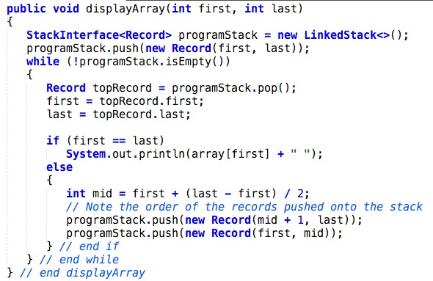
Using a Stack Instead of Recursion
Iterative version of displayArray

Slide 41
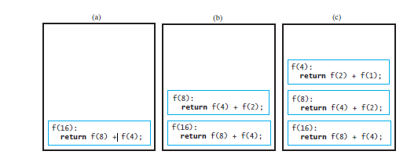
Group Exercises
Q1: Trace a call f(16) to the following method:
public int f(int n)
{
if (n < 4)
return 1;
else
return f(n/2) + f(n/4);
}

Slide 42
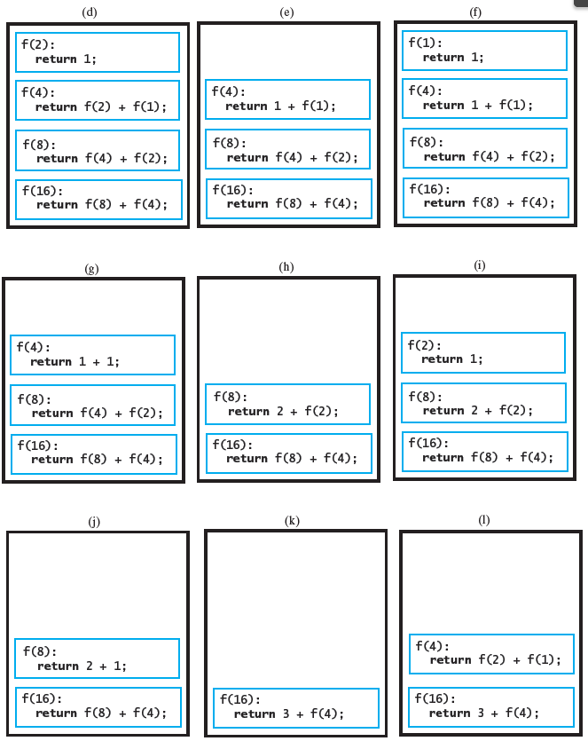
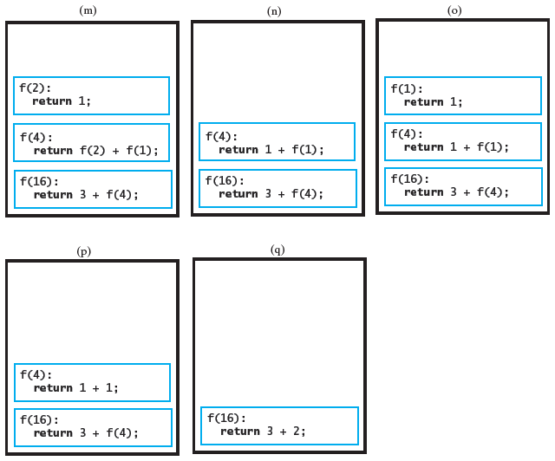

Slide 43
Q2
/** Recusively displays a row of characters.
* @param toShow - the character to print
* @param n - the number of times to print it
*/
public static void displayRowOfCharacters(char toShow, int n)
{
// base case
if (n < 1)
System.out.println();
// recursive case
else
{
System.out.print(toShow);
displayRowOfCharacters (toShow, n - 1);
}
}

Slide 44
Q3
/** Recusively counts the nodes in a chain.
* @param start - the first node
* @returns the number of nodes in the linked chain
*/
public int countNodes(Node start)
{
// base case
if (start == null)
return 0;
// recursive case
else
return 1 + countNodes(start.next);
}

Slide 45
Q4
/** Recusively displays a portion of an array backward.
* @param a - the array to display
* @param first - index of the first element
* @param last - index of the last element
*/
public static void displayBackward(Object[] a,
int first, int last)
{
// recursive case
if (first <= last)
{
displayBackward (a, first + 1, last);
System.out.print(a[first]);
}
}

Slide 46
Q5
// Recursively computes a factorial of a given number n
public static int factorial(int n)
{
if (n < 2)
return 1;
//recursive case
return n * factorial(n-1);
}
public static int tailFactorial(int n, int subTotal)
{
if (n < 2)
return 1 * subTotal;
//recursive case
return tailFactorial(n-1, subtotal * n);
}

Slide 47
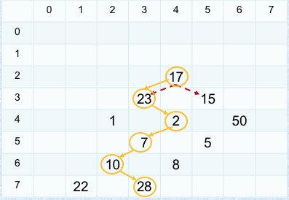
Q6
Consider a checkerboard that has a dollar amount printed on each of the squares. You can place a checker on the board anywhere you want and then move it down the board with standard diagonal moves. Once you reach the bottom, you are finished. You will collect an amount of money equal to the sum of the values written on the squares that your checker traveled over. The move will be decided based on the value, whichever is larger, i.e.: 23 is greater than 15 so the first move will be down left, second move will be down right and so on.
Give a recursive algorithm that will compute the amount collected by moving either down left: [r+1, c-1] or down right: [r+1, c+1] until the last row is reached. For simplicity assume that board[r][c] will be 0 if either r or c is out of range.
int maxSum(int[][] board, int size, int r, int c)
…
if (r < size)
{
if (board[r+1][c-1] >= board[r+1][c+1]
return board[r][c] + maxSum(board, size, r+1, c-1)
else
return board[r][c] + maxSum(board, size, r+1, c+1)
}
return 0

